Slide 1




DIGITAL LITERACY
SKILLS
INTERMEDIATE USERS

Slide 2

Module 5
Safety and security

Slide 3

4
Unit 4: Protecting the environment

Slide 4
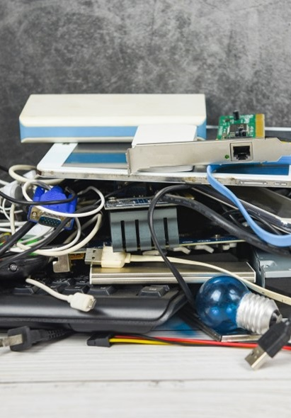
Proper disposal of electronic devices
Computers and other electronic devices contain different metals, plastics, raw materials and chemicals, and need to be disposed of correctly.
Types of electronic devices include:
computers, smartphones, and tablets
digital media
external hardware and peripheral devices
gaming consoles.

Slide 5
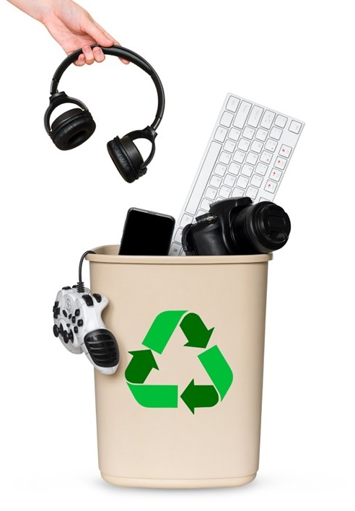
Safely disposing of out-of-date electronic devices
Electronic waste, or e-waste, is a term used to describe electronics that are nearing the end of their useful life and are donated or recycled.
Dispose of e-waste by contacting a business that specializes in e-waste disposal and requesting a designated e-waste drop off location.
Be aware that, although there are many options for disposal, it is your responsibility to ensure that the location chosen is reputable and certified.

Slide 6
Skills to practise
Research the impact of technology on the environment
Make a list of the electric machines found in your home and community.
Complete an internet search on each to find out the amount of electricity each consumes.
Research alternative ways to complete the tasks that the machines do, while reducing the amount of electricity used. Note that some machines are essential, and the aim is not to get rid of the machines, but to rather use them more efficiently.
Complete an internet search on ‘electronic waste’ and electronic recycling’. Create a strategy on how to encourage recycling and reduce waste.

Slide 7
All back covers should include
contact information of the section
producing the work.
© United Nations Children’s Fund (UNICEF) [month and year of publication]

